Slide 1

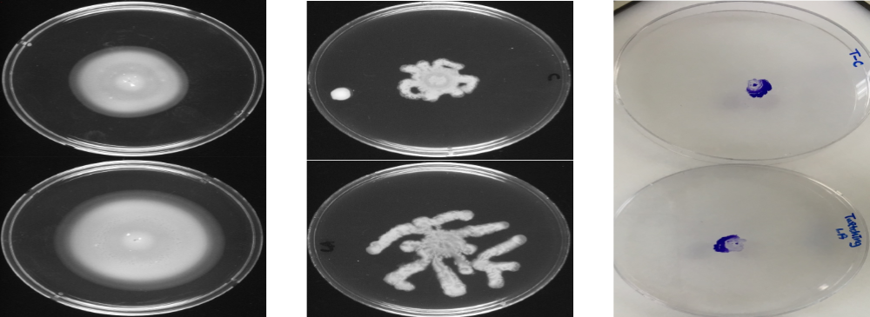
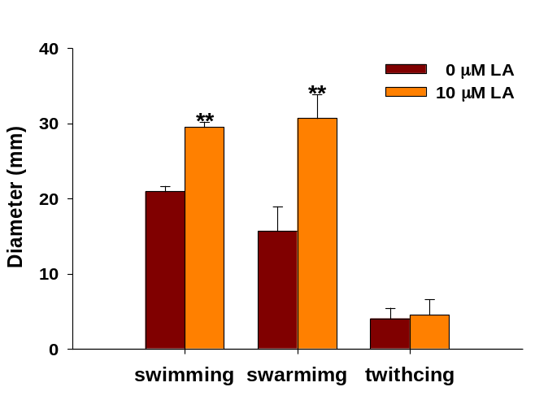
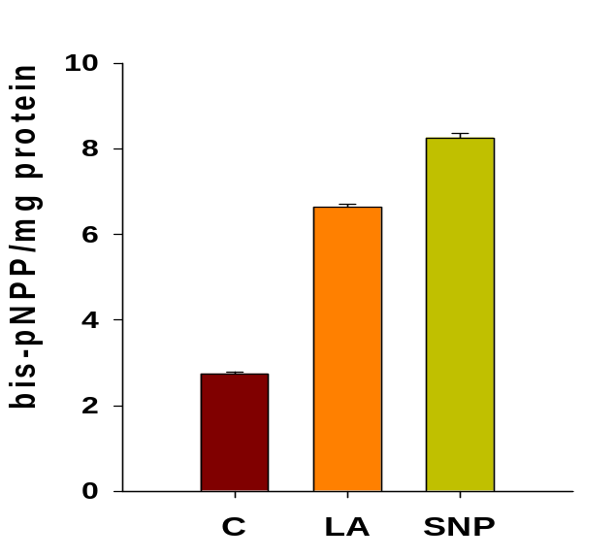
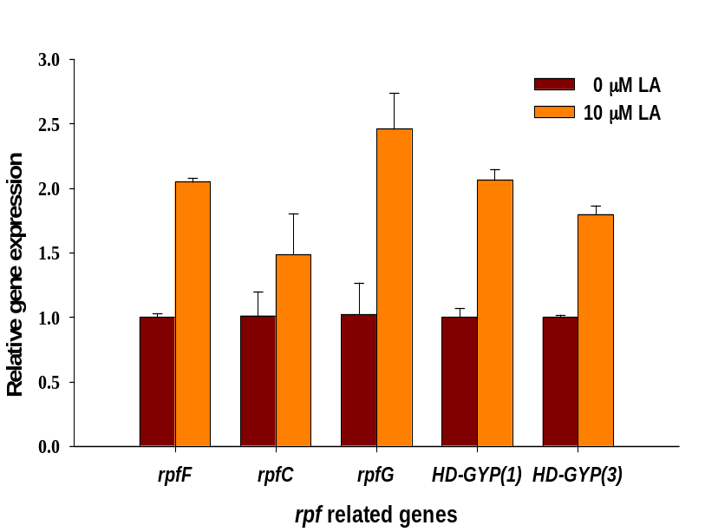
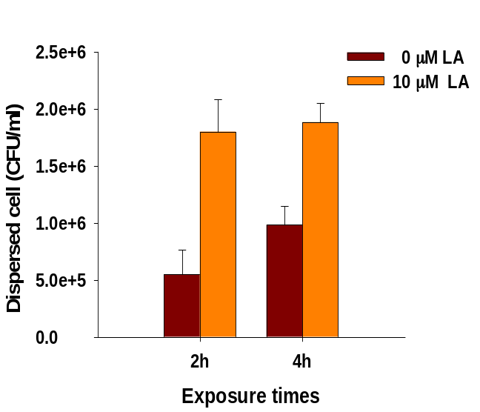
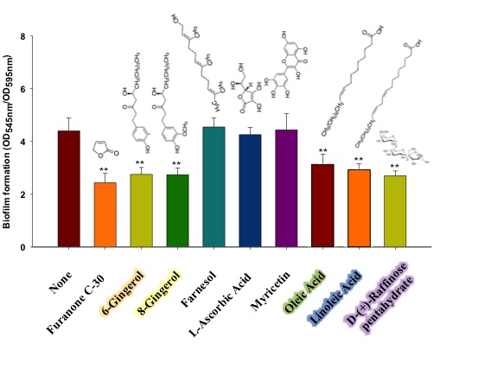
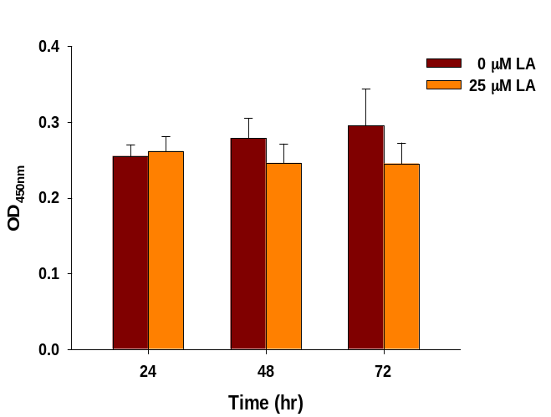
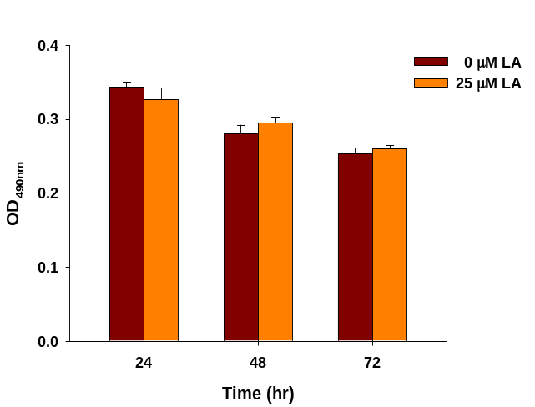
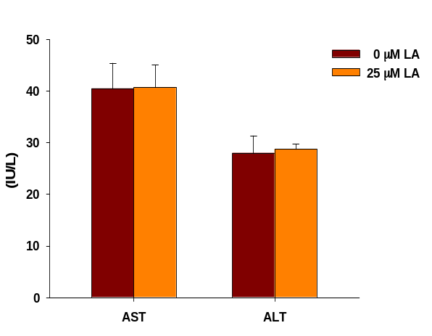
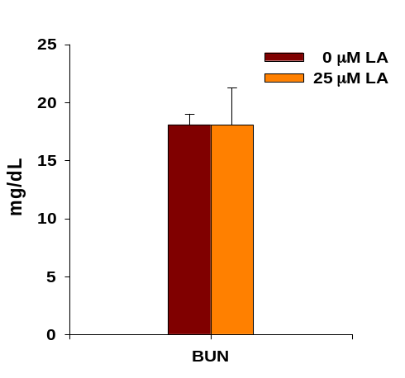
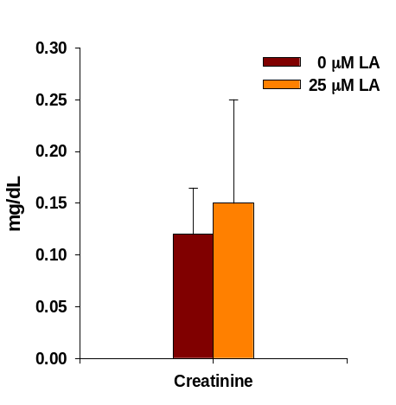
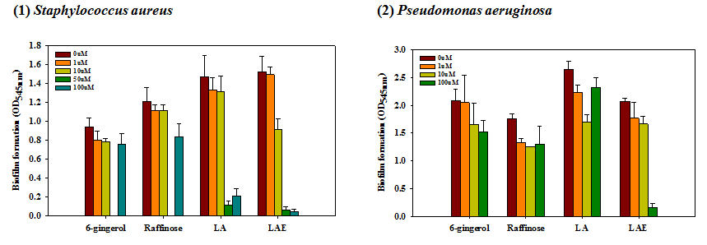
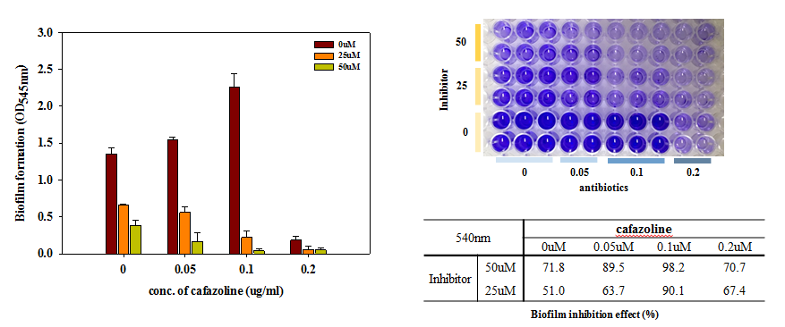
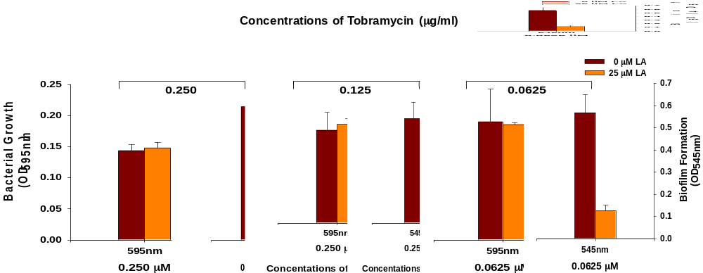
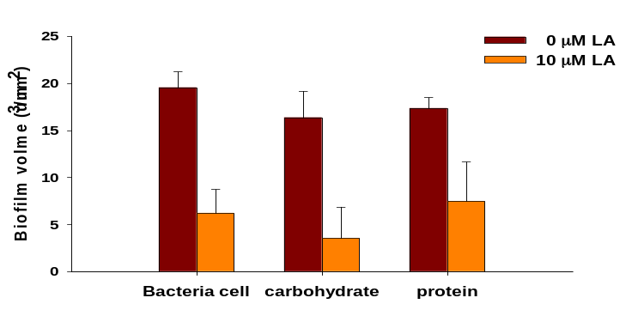
Gang-Jee Ko¹ , Han-Shin Kim², Eunji Cha², So-Young Ham², Shin Young Ahn¹, Eun Jung Cho¹, Ji Eun Kim¹, SYoung Joo Kwon¹ and Hee-Deung Park²
Department of Internal Medicine, Korea University College of Medicine, Guro Hospital¹;
School of Civil, Environmental and Architectural Engineering, Korea University²
Linoleic acid co-treatment inhibits bacterial biofilm formation (S. aureus and P aeruginosa) in continuous ambulatory peritoneal dialysis (CAPD) catheter
BACKGROUND
Peritonitis is a serious complication in patients receiving PD responsible for significant morbidity and technical failure. Biofilm formation of catheter is considered as an underlying mechanism for relapsing, recurrent and intractable peritonitis. However, little has been known to prevent it. Linoleic acid (LA) is one of the unsaturated fatty acids which has been found in plant, fruit, oil and as one of the elements of ginger extract demonstrated an inhibitory effect on biofilm of industrial and environmental settings such as water pipes system. Here we aimed to investigate the protective effect of linoleic acid (LA) on catheter biofilm formation.
MATERIALS & METHODS
Growth inhibitory test
Static biofilm formation assay
EPS analysis
Swarming motility assay
QS inhibition assay
In vivo and vitro toxicity analysis
In vitro synergistic effect examination with antibiotics
RESULTS
Comparisons of motility on the 10 μM LA treatments
Swimming
Swarming
Twitching
0μM LA
10μM LA
The change of motility under 10 µM linoleic acid. (Upper) Representative swimming/ swarming /twitching agar plates.
(Lower) The length of dendrites generated by swimming/ swarming /twitching motility.
LA biofilm inhibition mechanisms
(A)
**
(B)
**
**
**
*
**
**
Screening of active ingredients for using biofilm inhibitors
(C)
**
**
Analysis of intracellular c-di-GMP phosphodiesterase (PDE) activity.
The expression of rpf related genes with or without LA (10mM).
Dispersed cell after 10 mM LA treatment at different exposure times.
Cytotoxicity on human cells and mice with LA treatments
LDH
MTS
The components of ginger extract which showed inhibitory effect on biofilm formation were chosen from previous studies.
Kim et al, 2015, Scientific reports 5, 8656
Kim et al, 2016, Scientific reports 6, 25318
Choi et al, 2017, Journal of medicinal chemistry, 60(23), 9821-9837
Mice liver function test
Biofilm inhibition cause by S. aureus and P. aeruginosa with 0 - 100 μM various ginger extracts and LAE
Mice renal function test
Synergistic effect on biofilm inhibition by combination treatment of LA with cefazolin and tobramycin
All three components from ginger extract (6-gingerol, Raffinose, and Linoleic acid) and Lauroyl Arginate Ethyl (LAE), known as a bio-friendly preservative showed biofilm inhibition effect.
Linoleic acid was chosen as a key molecule, because it showed the strongest effect among ginger extract, and natural ingredient, which was expected to have minimal cytotoxicity.
Inhibition effect of LA on biofilm formation and EPS production
Bacteria cell
Carbohydrate
Protein
0μM LA
10μM LA
**
**
Conclusion
Linoleic acid (LA), which is one of the unsaturated fatty acids. showed an inhibitory effect on bacterial biofilm formation under static and flow conditions via quorum sensing (QS) interference and reduction of a secondary messenger, cyclic diguanylate (c-di-GMP). In addition, combination treatment of linoleic acid with antibiotics inhibited bacterial biofilm formation more effectively.
Bio-volume of biofilm consist of bacteria and EPS with carbohydrate and protein was reduced by LA treatment in dose-dependent manner

